Slide 1
BIG DATA ANALYSIS WITH IBM CLOUD DATABASES
PHASE :5

Slide 2
Problem Statement: Dive into the world of big data analysis with IBM Cloud Databases. Uncover hidden insights from vast datasets, from climate trends to social patterns. Visualize your findings and derive valuable business intelligence. Embark on data-driven adventure, exploring the endless possibilities of big data!

Slide 3
Problem Definition: The project involves delving into big data analysis using IBM Cloud Databases. The objective is to extract valuable insights from extensive datasets, ranging from climate trends to social patterns.
The project includes designing the analysis process, setting up IBM Cloud Databases, performing data analysis, and visualizing the results
for business intelligence.

Slide 4
Design Thinking:
1.Data Selection
Objective: Identify the datasets to be analyzed, such as climate data or social media trends.
Analyzing big data often involves working with large and diverse datasets. Here are some examples of data sets.
Climate data:
NASA ‘s Global Climate Change Data
NOAA Climate Data
European Climate Data
Social Media Trends:
Twitter API Data
Facebook Graph API Data
Instagram API Data
Deliverable: The datasets of Climate Data or Social media trends are
downloaded and analyzed.

Slide 5
2.Database Setup
Objective: Set up IBM Cloud Databases for solving and managing large datasets.
IBM offers several cloud database options suitable for storing and managing large datasets.
IBM Db2 on Cloud
IBM Db2 Warehouse on Cloud
IBM Cloudant
IBM Cloud Object Storage
IBM TimeSeries Database
Deliverable: These datasets can handle large datasets and offer various features like scalability, reliability, security, and ease of management, making them suitable for big data applications.

Slide 6
3.Data Exploration
Objective: Develop queries and scripts to explore the datasets, extract relevant information, and identify patterns.
Understanding the Data
SQL Queries for Data Exploration
Identifying Relevant Information
Data Extraction
Pattern Identification
Scripting Tools For Automation
Statistical Analysis and Machine Learning
Deliverable: In this phase you gain insights and better understand the dataset.

Slide 7
4.Analysis Techniques
Objective: Apply appropriate analysis techniques, such as statistical analysis or machine learning, to uncover insights.
Statistical Analysis:
Descriptive Statistics
Correlation Analysis
Hypothesis Testing
ANOVA ( Analysis of Variance)
Machine Learning:
Data Preprocessing
Exploratory Data Analysis
Feature Engineering
Model Selection
Model Training and Evaluation
Hyperparameter Tuning
Interpretation of Results
Ensemble Learning
Deliverable: The Both Statistical Analysis and Machine Learning techniques can provide valuable insights of Analysis Techniques. The choice of the technique depends on the nature of the data and the specific questions you aim to answer.

Slide 8
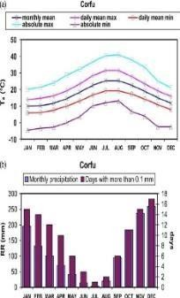
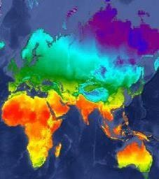
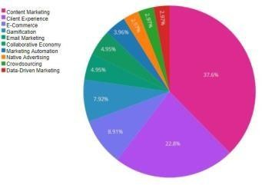
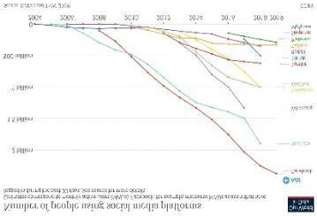
5.Visualization
Objective: Design visualization to present the analysis results in an understandable and impactful manner.
To visualize the analysis results we need to use some tools such as:
Google Charts
Tableau
Infogram
ChartBlocks
Types:
Column Chart
Area Chart
Pie Chart
Scatter Plot Chart
Bar Graph
Line Graph
Bullet Graph

Slide 9
Deliverable: To represent the analysis results in visualization tools can
provide valuable insights in an understandable and impactful manner.
6.Business Insights
Objective: Interpret the analysis findings to derive valuable business intelligence and actionable recommendations.
Finding new customers
Increasing customer retention
Improving customer service
Better managing marketing efforts
Tracking social media interaction
Predicting sales trends
Deliverable: These are helps to provide insights that improve the way our society functions.

Slide 10

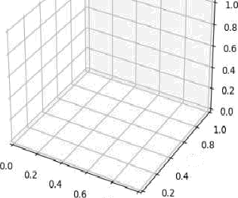
jupyter Untitled9 Last Che oinl. a few seconds ago unsaved changes
File Edil \/ie\v Insert Cell Kernel 'AidgeB Help
# Python 3 iipykemel) 0
In [1] : inert nunpy a's n p
+zg = p1t . +z gure ( )
ax = pit.axes (project IDA = ' 5c ' )
0.0
0.8
1.0

Slide 11

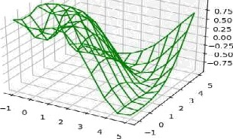
/“' y u pyte r Untitlecl 1O Law Ctmc8p'oin'4. 3 mMutes aqo ïuna.aveo el aripesï
”
- .
“
"
”
”
Iw I"I- °•*• mr' tw .lí
’L wpGíGU
*C r’)’’’
-ntiurn np.•szn(n .sent( x•ond v oms
« - np.iïnspare(-i„ a, io)
r, v - np.wshgr U(r; y)
--• (x. ?)
plc - rn..Uma()
ar -.pJf.nws(pvoy -4nn -'An')
ax:proc wlceCraweCxj 7, i, roloc -'green’) ñr.•s _?j l (•’?nwP am •’j;
oiretrume

Slide 12
Conclusion
This project is aims to develop into big data analysis using IBM Cloud Databases. The objective is to extract valuable insights from extensive datasets, ranging from climate trends to social patterns. The project includes designing the analysis process, setting up IBM Cloud Databases, performing data analysis, and visualizing the results for business intelligence. By following this structured approach, we will develop a highly effective and user-friendly virtual guide that meets the project’s objectives.

